Slide 1
Introduction to AWS
Amar Ganeshkar

Slide 2
What is Amazon Web Services(AWS)

Slide 3
What is Amazon Web Services(AWS)
Amazon Web Services offers a broad set of global cloud-based products including compute, storage, databases, analytics, networking, mobile, developer tools, management tools, IoT, security, and enterprise applications: on-demand, available in seconds, with pay-as-you-go pricing.
What is AWS ? Amazon Web Services (AWS) is the world's most comprehensive and broadly adopted cloud platform, offering over 200 fully featured services from data centers globally.

Slide 4
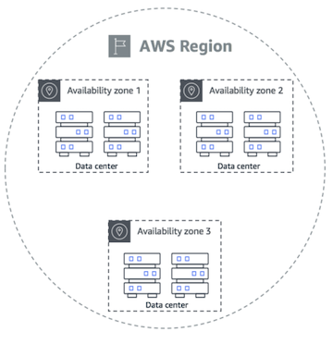
Region and Availability Zones
Region - separate geographic area
Availability Zones - isolated locations/ data centers within each Region

Slide 5
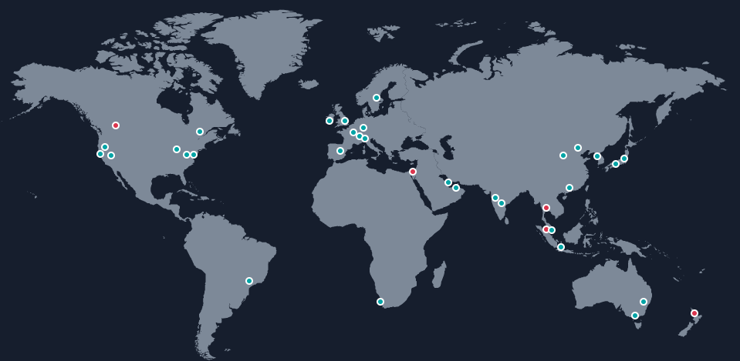
AWS Global Data Centers
Geographic Regions- 31
Availability Zones - 99
Edge Locations - 410+
Countries- 245
Direct Connect Locations- 115
Coming soon 5-AWS Region and 15 more Availability Zones

Slide 6
Understanding AWS Free Tier
Types Of Offers:
12 month Free: - EC2 & ELB - 750 Hour, ECR - 500 MB - S3 & EFS - 5GB, CLoudFront - 1 TB, ELB- 30GB, ECS - 2200 Hours - RDS,ElastiCache - 750 Hours, DynamoDB- 25GB,Redshift- 2 Month
Always Free: Lambda,SQS & SNS - 1 million,DynamoDB- 25GB, CloudWatch - 10,SES- 6200 messages/month
Trials: Sagemaker & Redshift- 2 months, Appstream 2.0- 40 Hours

Slide 7
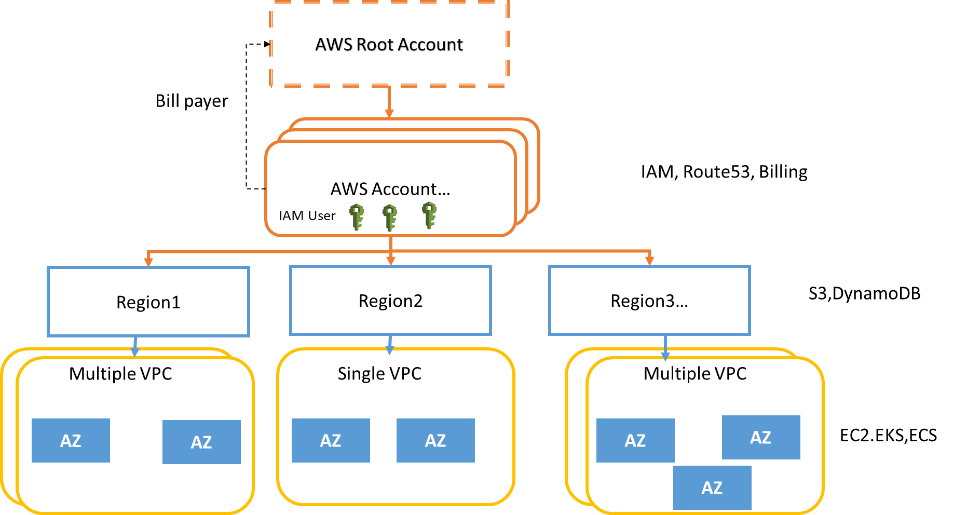
AWS Organizations and account structure:

Slide 8
Configure AWS IAM User
Create IAM admin user
IAM Service -> Users -> Add User
Access Type: Programmatic Access, AWS Management Console
Console password: Custom password
Select - Users must create a new password at next sign-in : Yes
Next Permissions: Attach Existing Policies directly -> Select “Administrator Access”
Review and create User
Save credentials
AWS Login URL
IAM username/password
IAM Access key/Secret Access key pair
Download CSV
Logout from current root user session and Login back using sign-in link and IAM username/password that you find in the downloaded CSV/Excel

Slide 9
Set Billing Alarm for your AWS account
Set Billing Alarm
Login to AWS account using Email/Password
Billing Dashboard -> Preferences -> Receive Billing Alerts
Create Billing Alarm
CloudWatch -> Select N.Virginia region
Alarms -> Billing -> Create Billing Alarm
Grant IAM users permissions for Billing and Cost management
My Account -> IAM User and Role Access to Billing Information -> Activate

Slide 10
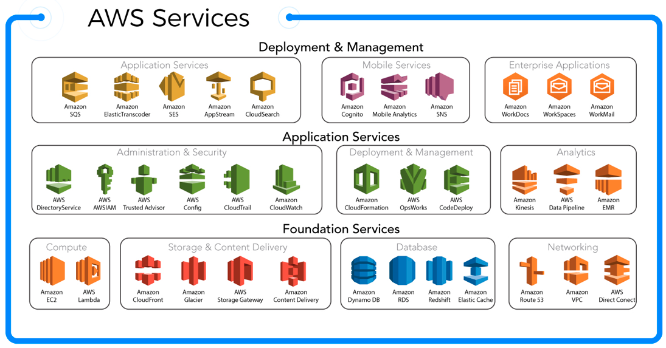
Understanding about AWS services

Slide 11
Launch EC2 Instance
Initiate instance launch link
Step 1: Open the Amazon EC2 console at https://console.aws.amazon.com/ec2/
Step 2: From the Amazon EC2 console dashboard, choose Launch instance.
Step 3: Choose an Amazon Machine Image (AMI)
Step 4: Choose an Instance Type
Step 5: Configure Instance Details
Step 6: Add Storage
Step 7: Add Tags
Step 8: Configure Security Group
Step 9: Review Instance Launch and Select Key Pair

Slide 12
Thank You

